Slide 2
Short-circuited quadrifilar helix (S-C QHA)
Antenna 1 : Results

Slide 3
Short-circuited quadrifilar helix (S-C QHA)
Antenna 1 : sketches, objectives and parameters

Slide 4
Antenna Structure: Antenna Parameters
Name | Description
f₀ | Centre frequency
Rin | Input resistance
P | Polarisation (transmitting)
N | Number of turns
Rh | Helical element radius
Rg | Ground plane radius
Hh | Helical element height
Hf | Height of the feed sections
D | Wire diameter
X | Device X-dimension

Slide 5
Antenna Structure: Antenna Parameters (2)
Name | Description
Y | Device Y-dimension
Z | Device Z-dimension
Lw | Length of one volute

Slide 6
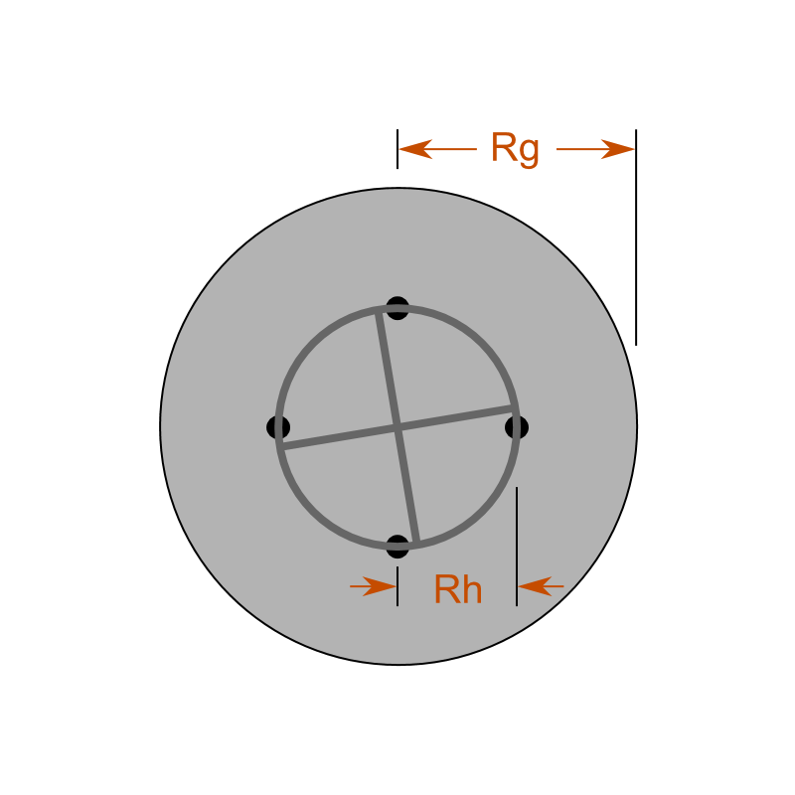
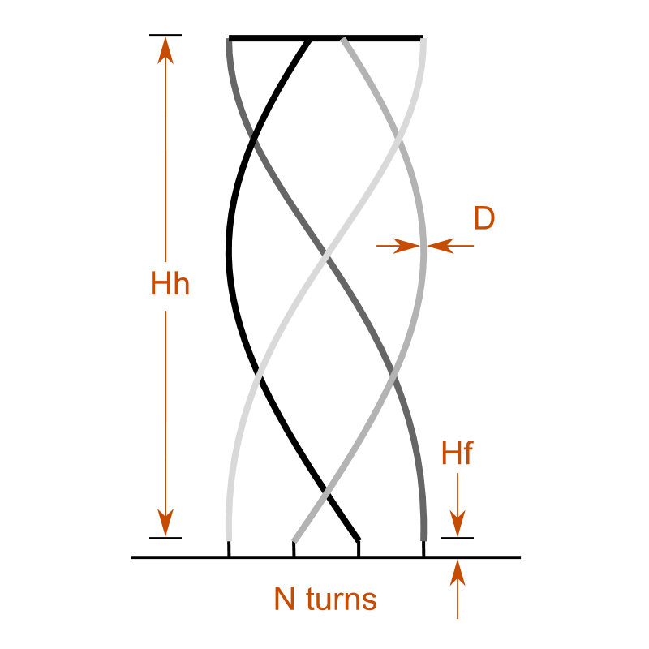
Sketches
Top view
Side view

Slide 7
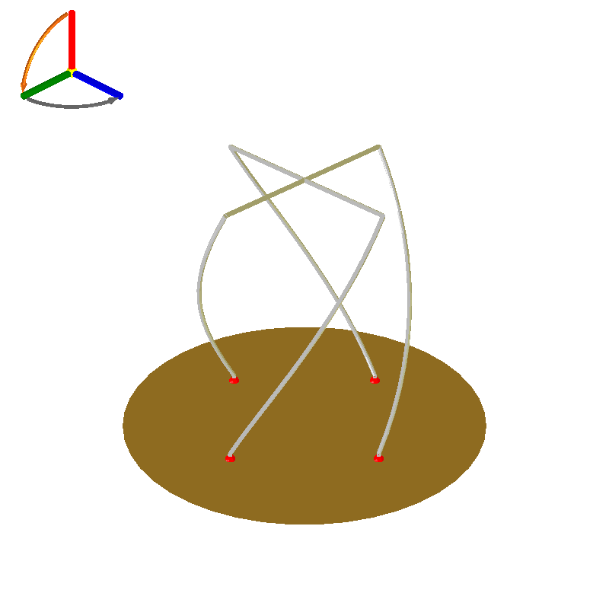
Tweak 9-1: Preview

Slide 8
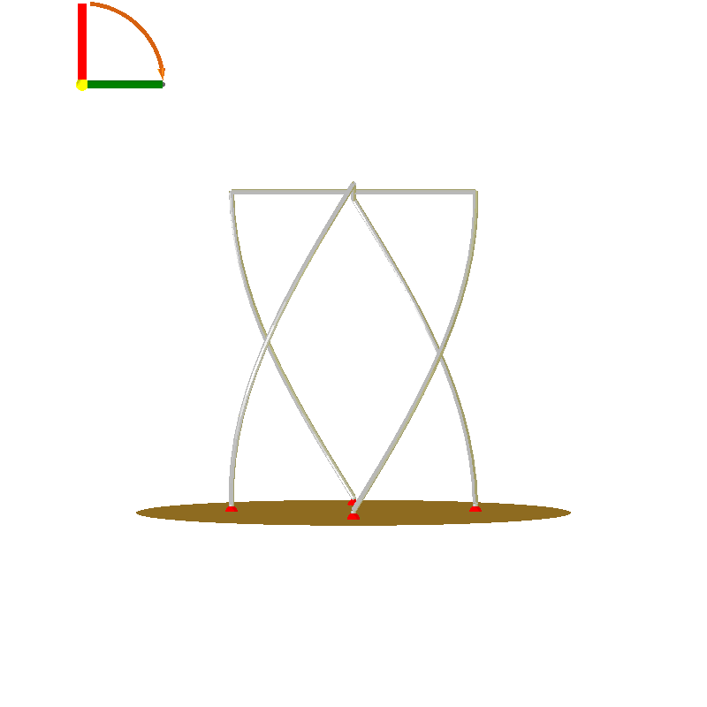
Tweak 9-1: Front Side Preview

Slide 9
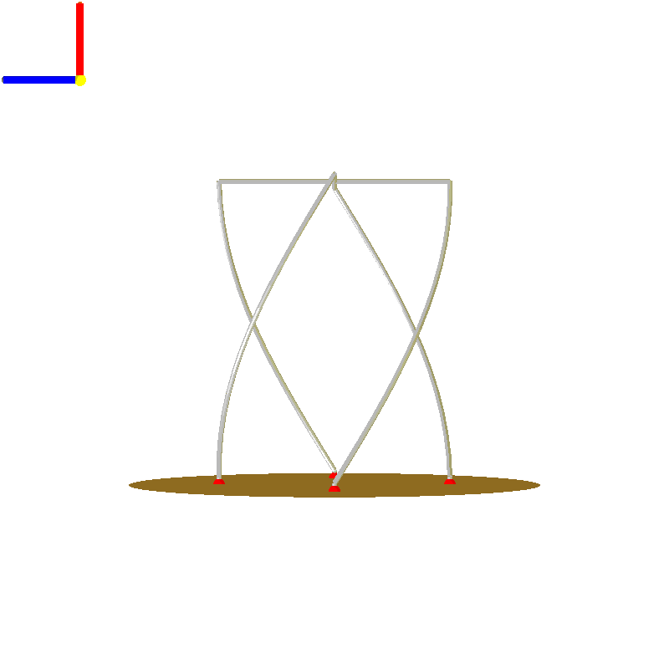
Tweak 9-1: Left Side Preview

Slide 10
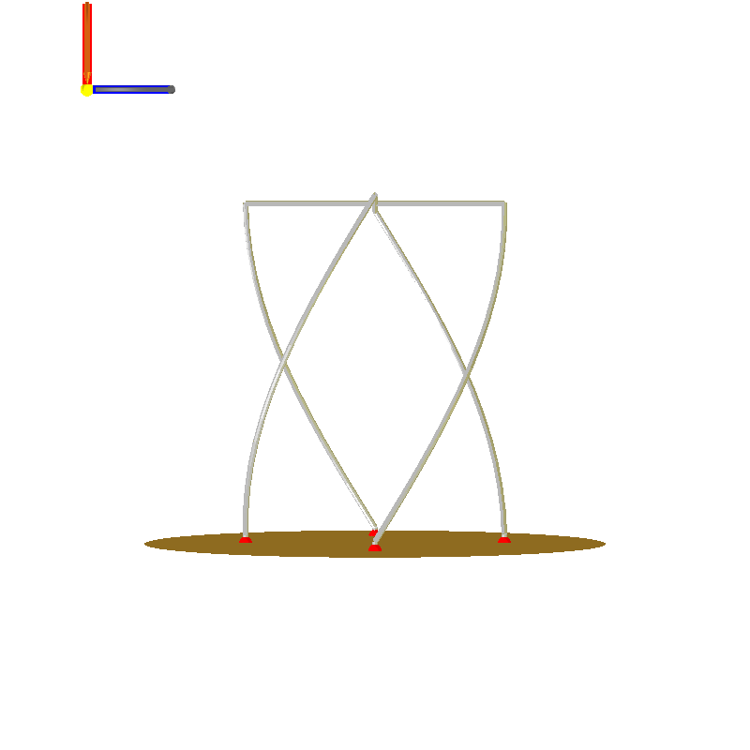
Tweak 9-1: Right Side Preview

Slide 11
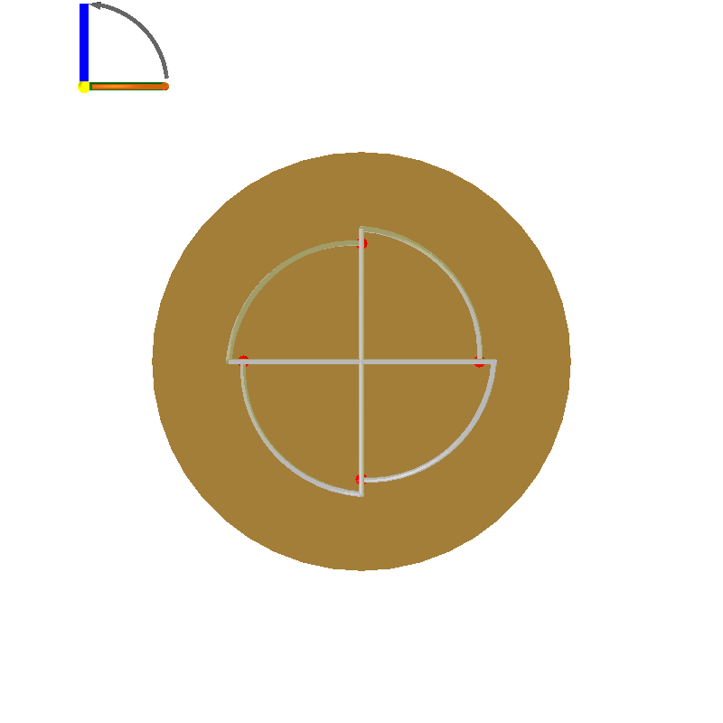
Tweak 9-1: Top Side Preview

Slide 12
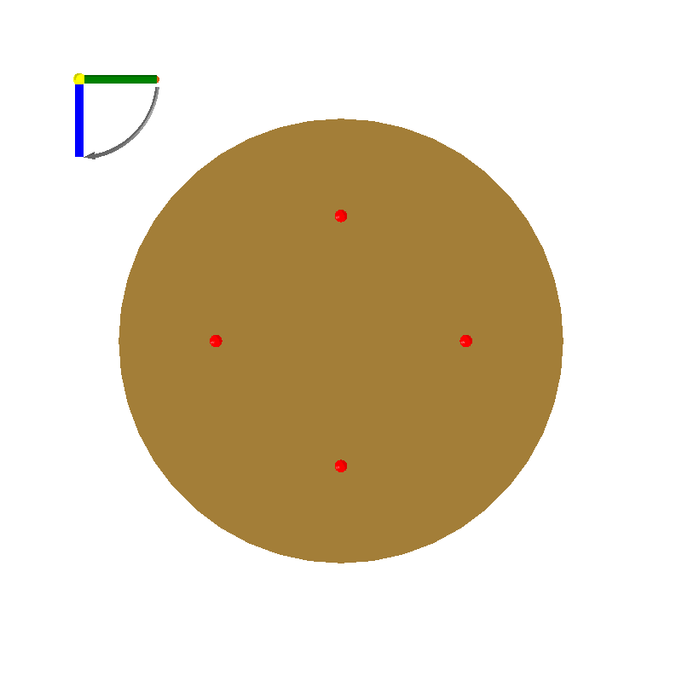
Tweak 9-1: Bottom Side Preview

Slide 13
Tweak 9-1: Design Objectives
Objective Group: all options
Name | Description | Value
f₀ | Centre frequency | 430 MHz
P | Polarisation (transmitting) | Righthand circular polarisation
bw | 3dB beamwidth | 150 °
Rin | Input resistance | 45 Ω

Slide 14
Tweak 9-1: Physical Parameters
Name | Description | Value
N | Number of turns | 0.25
Rh | Helical element radius | 90 mm
Rg | Ground plane radius | 160 mm
Hh | Helical element height | 230 mm
Hf | Height of the feed sections | 6 mm
D | Wire diameter | 4 mm

Slide 15
Tweak 9-1: Derived Quantities
Name | Description | Value
X | Device X-dimension | 180 mm
Y | Device Y-dimension | 180 mm
Z | Device Z-dimension | 236 mm
Lw | Length of one volute | 270.0 mm

Slide 16
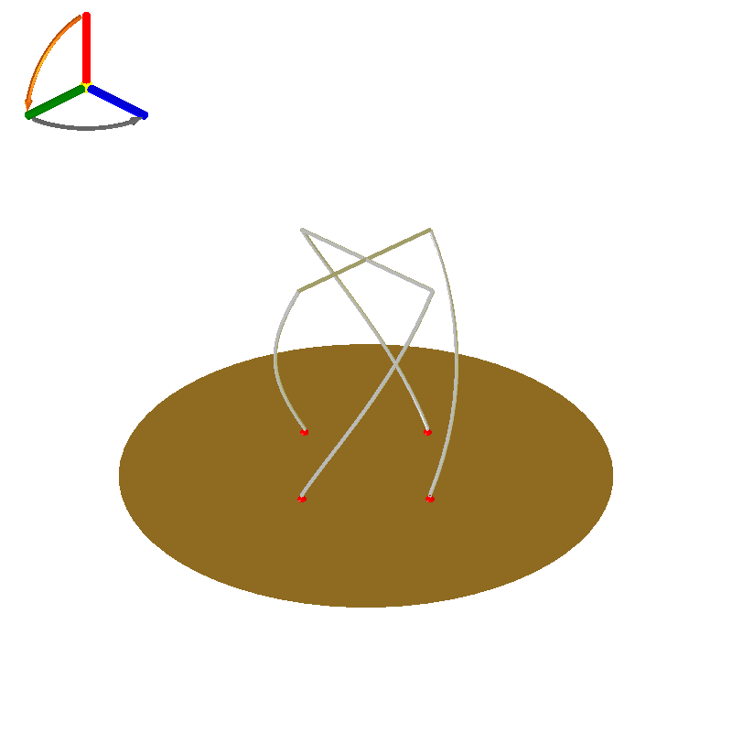
Tweak 9-3: Preview

Slide 17
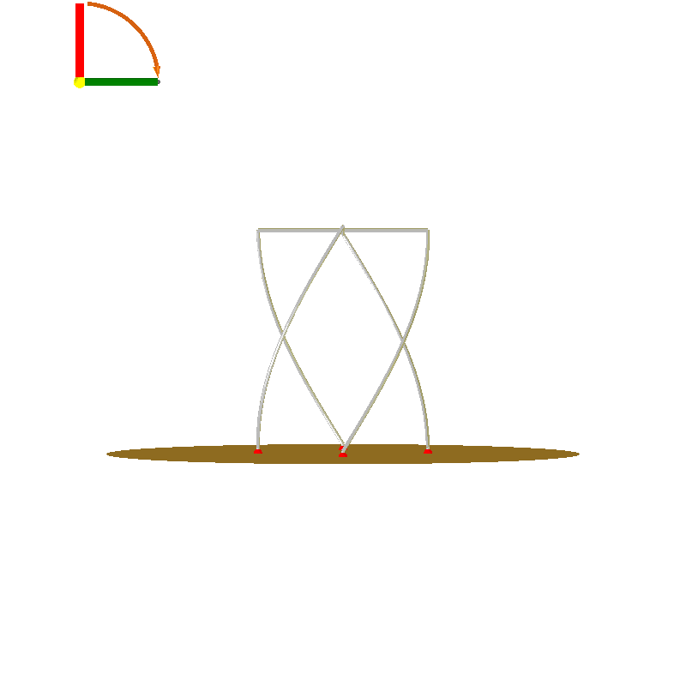
Tweak 9-3: Front Side Preview

Slide 18
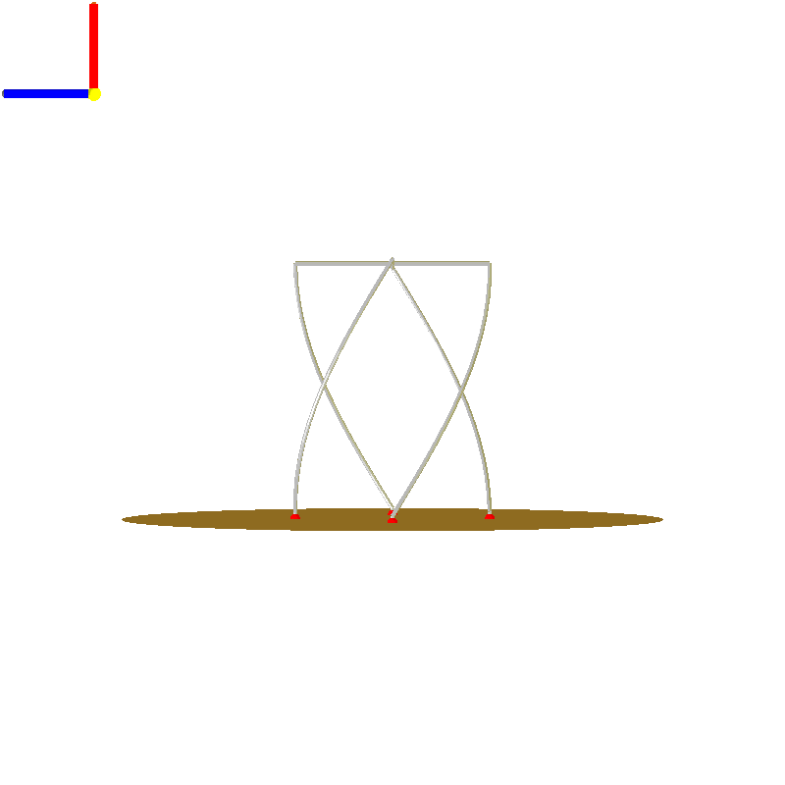
Tweak 9-3: Left Side Preview

Slide 19
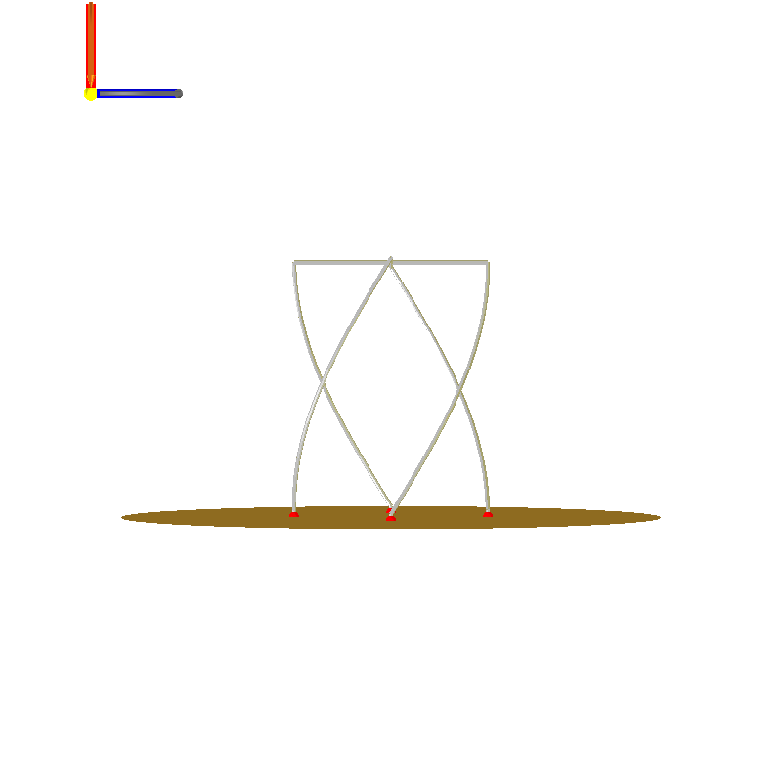
Tweak 9-3: Right Side Preview

Slide 20
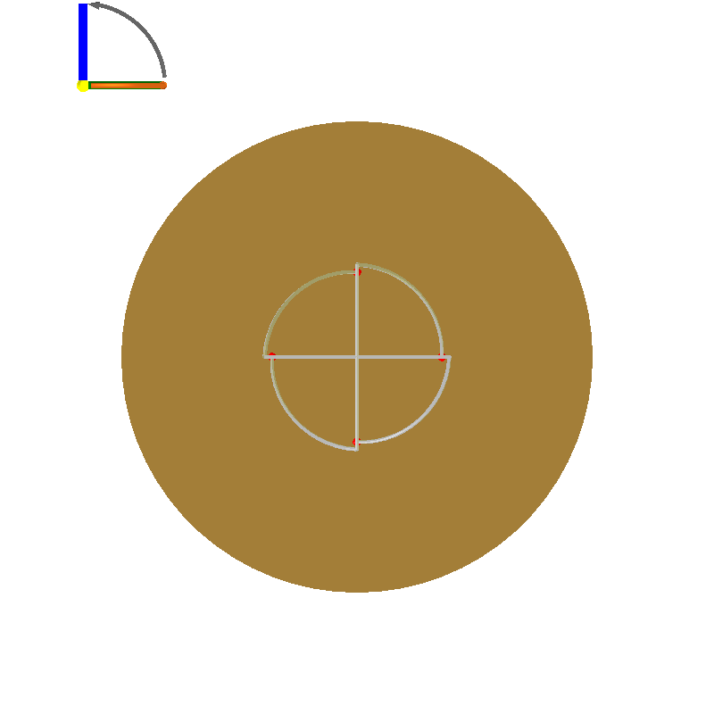
Tweak 9-3: Top Side Preview

Slide 21
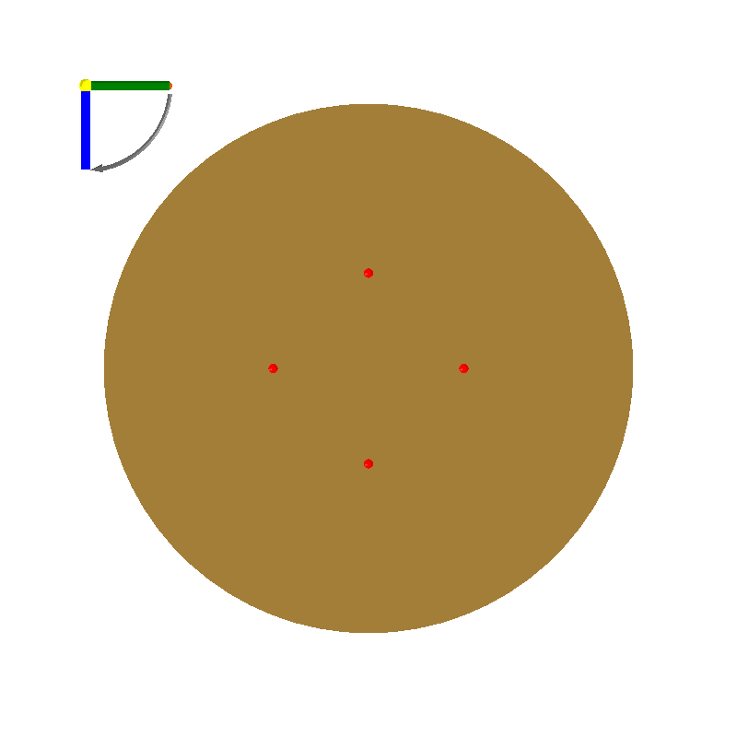
Tweak 9-3: Bottom Side Preview

Slide 22
Tweak 9-3: Design Objectives
Objective Group: all options
Name | Description | Value
f₀ | Centre frequency | 430 MHz
P | Polarisation (transmitting) | Righthand circular polarisation
bw | 3dB beamwidth | 150 °
Rin | Input resistance | 45 Ω

Slide 23
Tweak 9-3: Physical Parameters
Name | Description | Value
N | Number of turns | 0.25
Rh | Helical element radius | 90 mm
Rg | Ground plane radius | 250 mm
Hh | Helical element height | 230 mm
Hf | Height of the feed sections | 6 mm
D | Wire diameter | 4 mm

Slide 24
Tweak 9-3: Derived Quantities
Name | Description | Value
X | Device X-dimension | 180 mm
Y | Device Y-dimension | 180 mm
Z | Device Z-dimension | 236 mm
Lw | Length of one volute | 270.0 mm

Slide 25
Short-circuited quadrifilar helix (S-C QHA)
Antenna 1 : estimated performance charts

Slide 26
Impedance vs frequency

Slide 27
Impedance vs frequency

Slide 28
Impedance vs frequency
Reflection coefficient (20log|Γ|)
 | Tweak 9-1 | Tweak 9-3
Reference impedance @ port 1 | (45+0j) Ω | (45+0j) Ω

Slide 29
Impedance vs frequency

Slide 30
Impedance vs frequency
VSWR
 | Tweak 9-1 | Tweak 9-3
Reference impedance @ port 1 | (45+0j) Ω | (45+0j) Ω

Slide 31
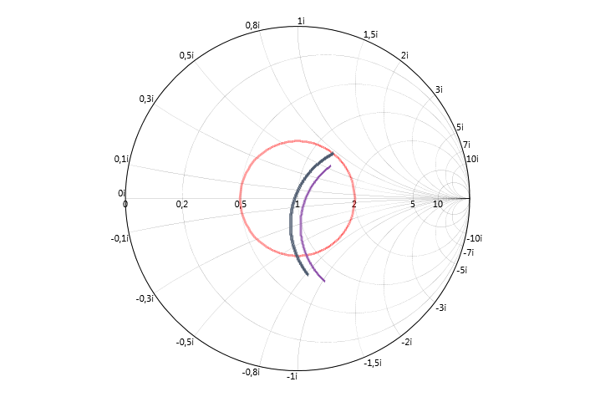
Impedance vs frequency
Input Impedance (Smith)

Slide 32
Impedance vs frequency
Input Impedance (Smith)
 | Tweak 9-1 | Tweak 9-3
Reference impedance @ port 1 | (45+0j) Ω | (45+0j) Ω

Slide 33
Radiation pattern

Slide 34
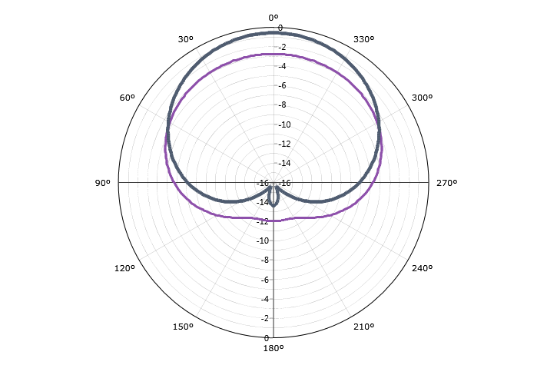
Radiation pattern
Gain (Total - normalised)

Slide 35
Radiation pattern

Slide 36
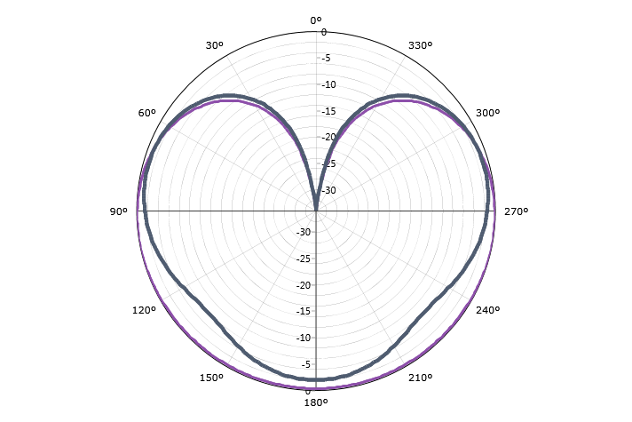
Radiation pattern
Gain (LHC - normalised)

Slide 37
Radiation pattern

Slide 38
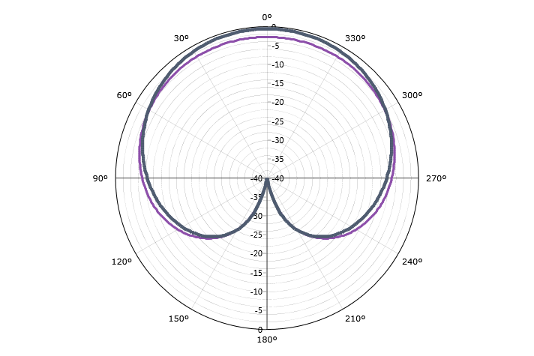
Radiation pattern
Gain (RHC - normalised)

Slide 39
Radiation pattern

Slide 40
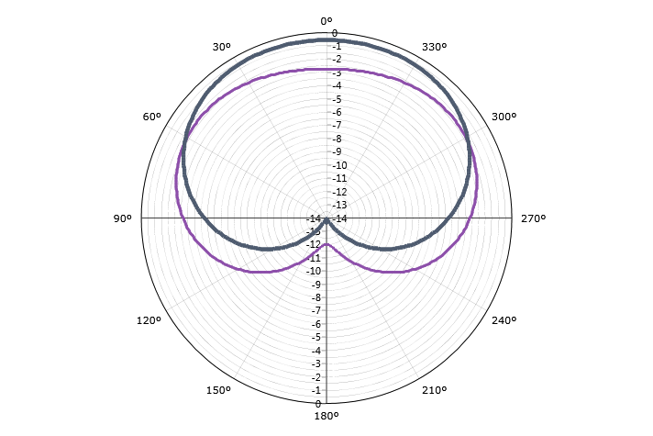
Radiation pattern
Gain (Horizontal - normalised)

Slide 41
Radiation pattern

Slide 42
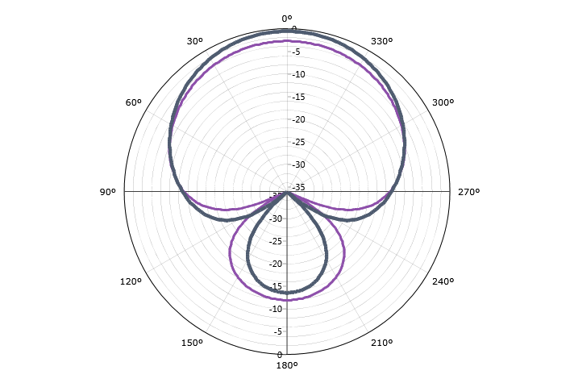
Radiation pattern
Gain (Vertical - normalised)

Slide 43
Radiation pattern

Slide 44
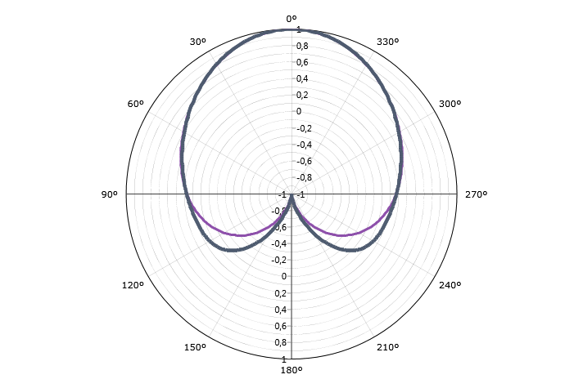
Radiation pattern
Axial Ratio (Handed)

Slide 45
Radiation pattern

Slide 46
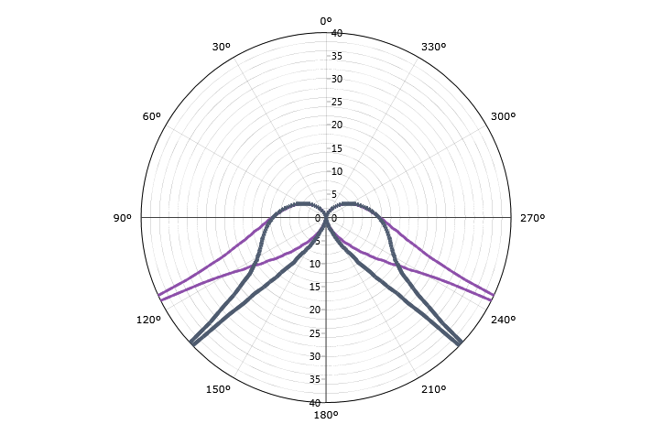
Radiation pattern
Axial Ratio (IEEE)

Slide 47
Radiation pattern

Slide 48
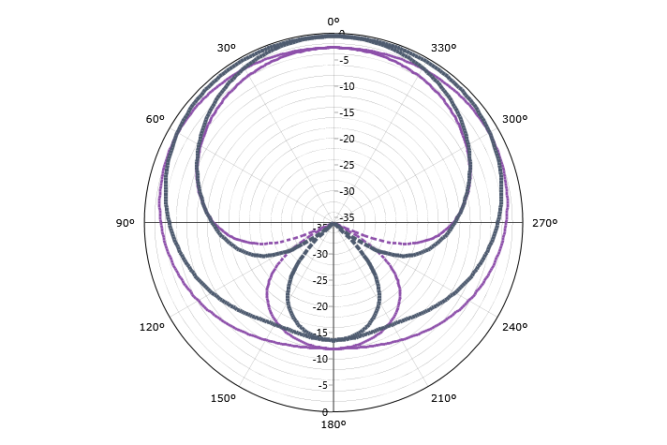
Radiation pattern
Ludwig III (Co)

Slide 49
Radiation pattern

Slide 50
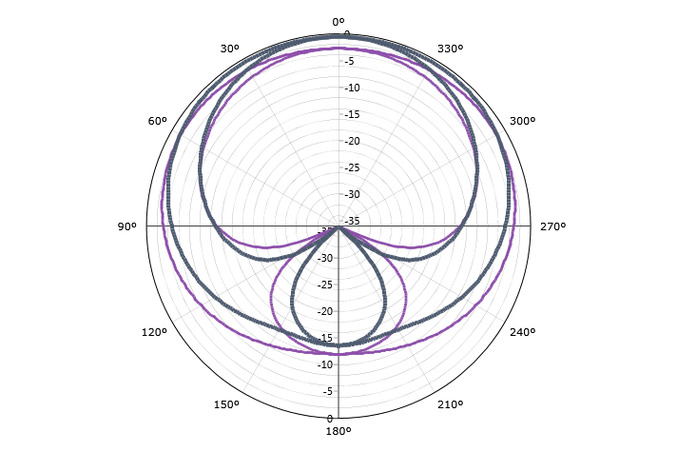
Radiation pattern
Ludwig III (Cross)

